Slide 1
Achieving Object Classification on an iPhone
Jennifer Yihan Ruan

Slide 2
Agenda
Project Overview
Methodology
Application
Future development

Slide 3
Project Overview
1

Slide 4
Project Overview
Using XCode implement a Core ML Model to an edged based device
Outcomes:
Object classification app - picture
Object classification app - video

Slide 5
Methodology
2
Object classification through picture
Object classification through video

Slide 6
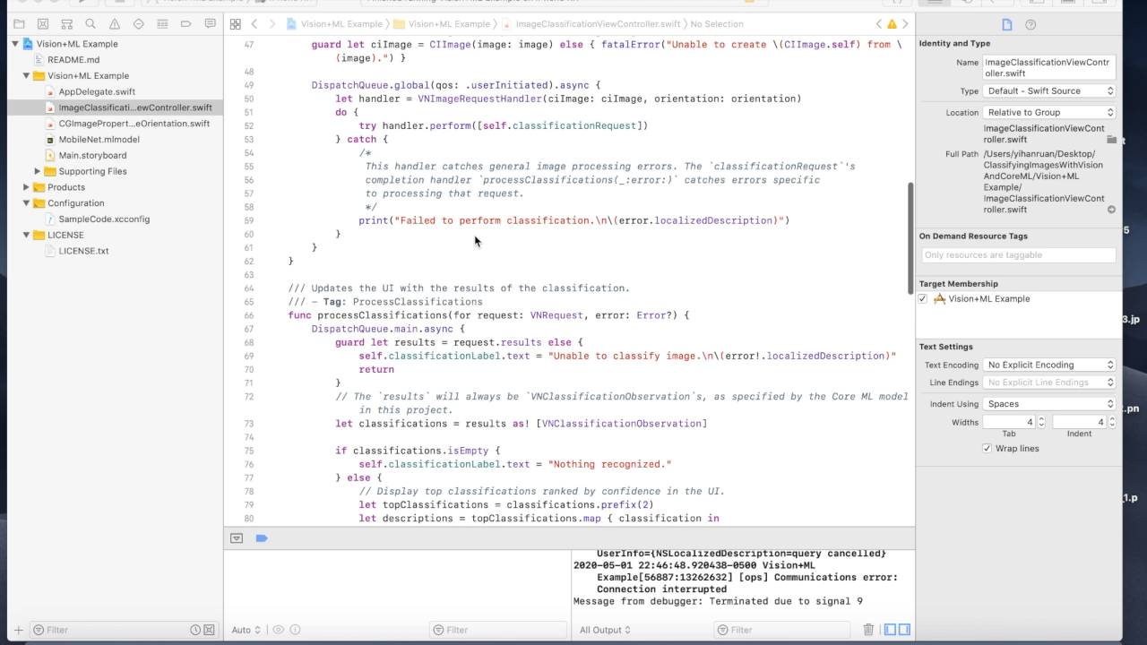
Code Source: https://developer.apple.com/documentation/vision/classifying_images_with_vision_and_core_ml

Slide 7


Slide 8

GitHub Link: https://github.com/scmzyh/computervision
Code Source: https://www.youtube.com/watch?v=p6GA8ODlnX0
Code Source: https://www.youtube.com/watch?v=SkgHz8nw5V8

Slide 9


Slide 10
Application
3

Slide 11




Get the name of the object you don’t know with pictures
Taking a picture of the item you would like to buy
Wearable technology for people with visual impairment
Mitigate potential risks of scanning wrong barcodes
Notes:
Image a product have a wrong barcode, it might still successfully checkout, but there might be a huge different between the wrong price and the correct one.
With this kind of technology, it can not only help customers to check whether they are taking risk to pay wrong price, but also mitigating risks for the supermarket

Slide 12
Future Development
4

Slide 13



Field of Medicine
Supervisory control
Robotics

Slide 14
THANKS!
Any questions?

